Slide 1
Windows Preparation
Kevin Shan

Slide 2
Pre-Competition Tips
Make sure VMware is fully updated to the latest software
Have sufficient time to actually download the images -- this may take several hours
Allocate more RAM to the image before you run it -- this will make it a lot faster/smoother
http://kb.mit.edu/confluence/pages/viewpage.action?pageId=148602892
Make sure you have a stable internet connection, as well as a power source (if you’re using a laptop)
Have all materials prepared before beginning the competition

Slide 3
WARNING
DO NOT by any means open several images at once on the same computer. You will be penalized for this.
DO NOT collaborate or share information with other teams or people outside of your team during the competition.
DO NOT open ANY of the virtual machines before the round starts on Saturday. As soon as you open one of the images (without even entering your unique id) your time will start. You can however extract the images and load them into the virtual machine, just don't power on the VM.
You have 6 hours total from when you open your first image to when you shut down and delete your last image. You do not have 6 hours for each image.

Slide 4
Resources to Prepare
Official Cyberpatriot resources: https://www.uscyberpatriot.org/competition/training-materials/windows
The training modules alone should be sufficient for the first round
Microsoft documentation (great for research): https://docs.microsoft.com/en-us/
General crypto resource for forensics: https://gchq.github.io/CyberChef/
Practice Images: https://magistrate.shiversoft.net/
https://www.google.com
I suggest creating your own checklist to aid in the competition

Slide 5
Beginning the Competition
Open the README first and skim/read it first
Open up the Scoring Report and verify the network status of the image
If the messages are still red after a while, there is something wrong with your network:
Internet Connectivity Check: Checks an image’s ability to connect to Google. If it fails, there is a problem with the image’s connection or something on the network is blocking access.
CCS Server Connection Status: Checks an image’s ability to connect to the scoring server. If it fails, you will need to troubleshoot your network connection.
CCS Server Score Upload Status: This checks an image’s ability to upload scoring data to the scoring server. A failure is usually the result of a proxy server or other security measure.

Slide 6

Connectivity Issues
If your connection status is not like this image, then there is something wrong with your network
Check that the internet to your actual computer is working
If that is working, also check the network inside your image - try troubleshooting the network, and restart the image
If the problem isn’t fixed, you can always just fully restart your image (delete the vm and re-extract)

Slide 7
Forensic Questions
Complete the Forensic Questions next
If any of the forensic questions involve physical files, make sure to KEEP those files if you haven’t completed the questions yet
If you decide to give up on a forensic question and the file is a vulnerability issue, record the location, properties, and other details of the files before doing so, in case you decide to work on it later.
Google is your best friend if you don’t know how to do a forensic question

Slide 8
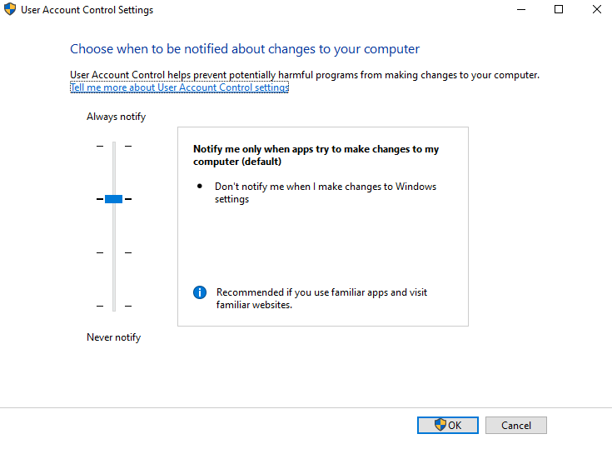
Background
Begin Windows updates early, because they might take a while (and you might even have to update multiple times)
Tip: close all applications before updating, or else you might cause issues
If sliding the User Account Control settings all the way up doesn’t give you points, just set it to “never notify” so you don’t have pop-ups

Slide 9
Quick Checklist of things for Round 1
Configure users accordingly to the README
Run through control panel items (Firewall, virus protection, etc.)
Using Godmode: https://www.online-tech-tips.com/computer-tips/enable-god-mode-control-panel-windows/
Uninstall unwanted software (Wireshark, Nmap, etc.) and update other software (Firefox, Internet Explorer, etc.)
Find and delete unwanted files (suspicious text files, media files)
Software to quicken search process: https://www.voidtools.com/
Update security policies
gpedit.msc, secpol.msc
Follow CIS Benchmarks: https://www.cisecurity.org/cis-benchmarks/
Disable/Enable/Configure services
You will (in later rounds) likely need to configure the critical services mentioned in the README
https://www.blackviper.com/service-configurations/black-vipers-windows-10-service-configurations/
Restart to fully update Windows

Slide 10
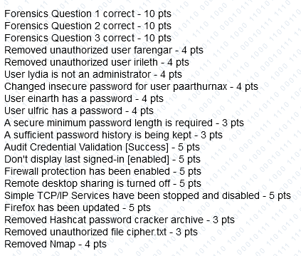
Practice Image Solutions

Slide 11
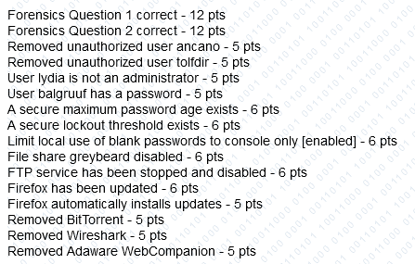
Practice Image Solutions

Slide 12
Additional Resources
Cyberpatriot Discord: https://discord.gg/mZTYCuSV
Old Cyberpatriot Lectures: https://activities.tjhsst.edu/cyberpatriot/lectures.html
Additional resources provided by Cyberpatriot: https://www.uscyberpatriot.org/competition/training-materials/additional-resources

